Slide 1
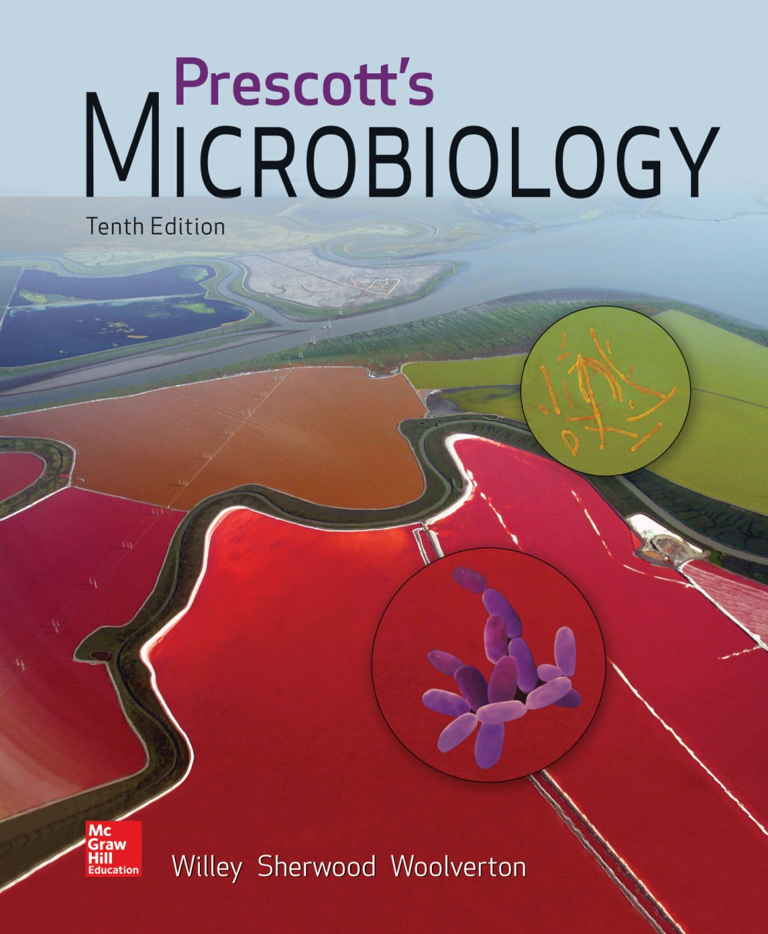
Chapter 26 – Fungi (Eumycota)

Slide 2
26.1 Fungal Biology Reflects Vast Diversity
Discuss the importance of fungi in their environment as well as their practical importance
Differentiate between a yeast and a mold, and between hypha and mycelium
Compare and contrast different spore morphologies
Explain how mating types govern sexual reproduction
Infer what is meant by a “dikaryotic fungus”
Assess the role of fungal decomposition on global carbon flux

Slide 3
True Fungi: Eumycota
Eukaryotic, spore-bearing
Chemoorganoheterotrophs with absorptive metabolism
Saprophytes
absorb nutrients from dead organic material by releasing degradative enzymes
osmotrophy - absorb soluble products
Lack chlorophyll
Reproduce sexually and asexually

Slide 4
Terminology
Mycology – study of fungi
Mycologists – scientists who study fungi
Mycoses – diseases caused by fungi
Mycotoxicology – study of fungal toxins and their effects

Slide 5
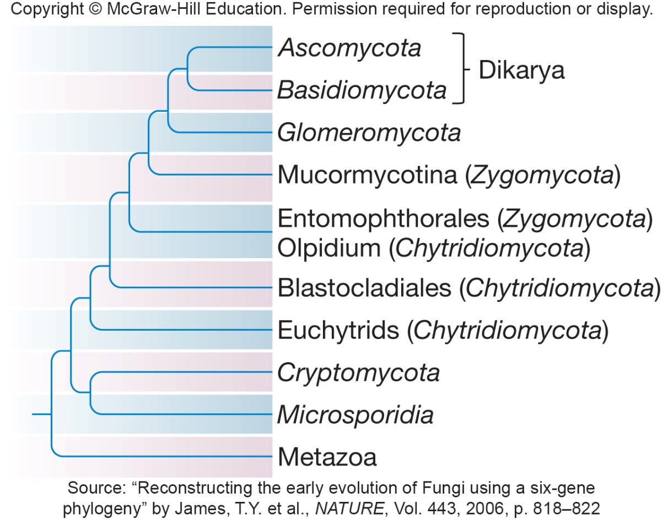
Taxonomy of Fungi
90,000 fungal species have been described, possible 1.5 million
Six major fungal groups
Chytridiomycota
Zygomycota
Glomeromycota
Ascomycota
Basidiomycota
Microsporidia

Slide 6
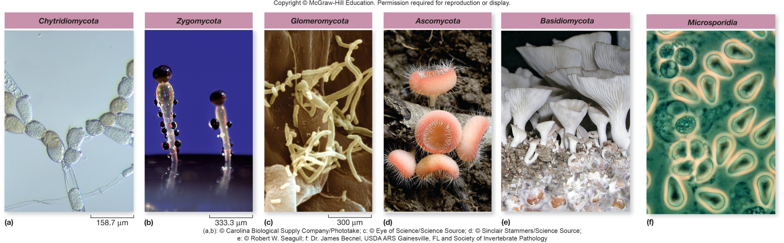
Tricky Taxonomy of Fungi
Basidiomycota and Ascomycota are dikarya
two parental nuclei are initially paired
nuclei fuse, undergo meiosis, produce haploid progeny
Zygomycota and Chytridiomycota are paraphyletic
taxonomic group includes some descendents of a single common ancestor

Slide 7
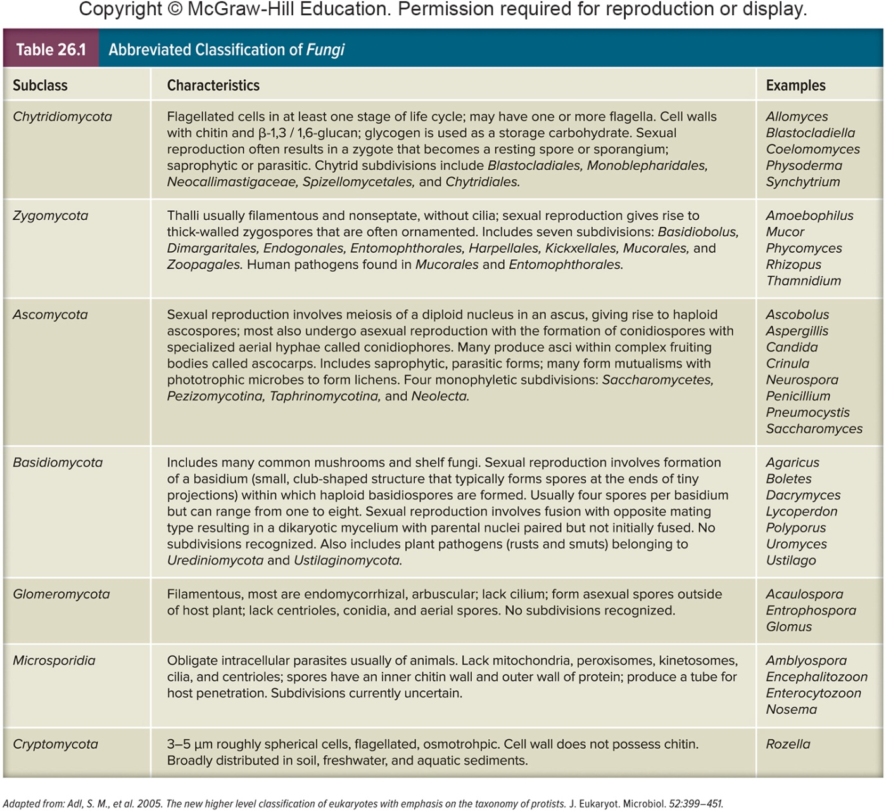
Abbreviated Classification of Fungi

Slide 8
Fungal Distribution and Importance
Primarily terrestrial, few aquatic
global from polar to tropical
Primarily terrestrial
few aquatic species
Many are pathogenic in plants or animals
Some form associations
mycorrhizae – associations with plant roots
lichens
associations with algae or cyanobacteria
Decomposers
degrade complex organic material in the environment to simple organic compounds and inorganic molecules
carbon, nitrogen, phosphorus, and other critical constituents are recycled for other living organisms

Slide 9
Fungal Distribution and Importance – Industrial and Research Use
Industrial importance
fermentation – yeast used in making bread, wine, beer, cheese, soy sauce
organic acids – citric and gallic acid
certain drugs – ergometrine, cortisone
antibiotics – penicillin, griseofulvin
immunosuppressive agents – cyclosporin
Research use
geneticists, cytologists, biochemists, biophysicists, and microbiologists
Saccharomyces cerevisiae
yeast model system for cell biology, genetics, and cancer

Slide 10
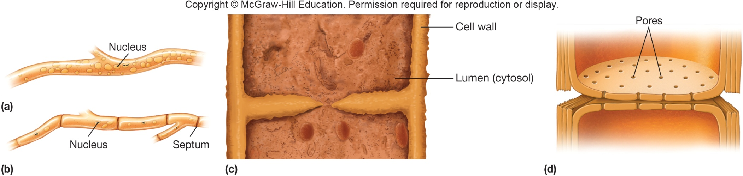
Fungal Structure
Cell walls composed of chitin polysaccharide
Single-celled microscopic fungi = yeasts
Body/vegetative structure of a fungus = thallus (pl. thalli)
multicellular fungi are called molds
thallus consists of long, branched hyphae filaments tangled into a mycelium mass

Slide 11
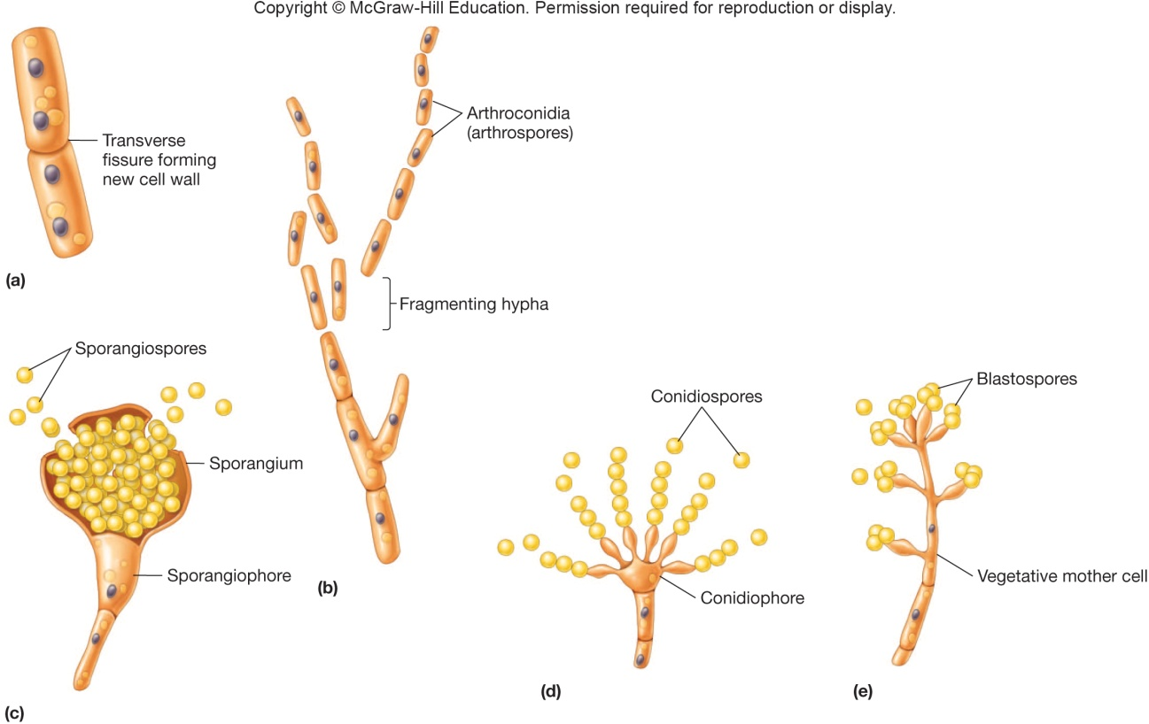
Fungal Reproduction
Asexual reproduction
Parent cell undergoes mitosis to form daughter cells
Mitosis in vegetative cells may be concurrent with budding to produce a daughter cell
May proceed through a spore form

Slide 12
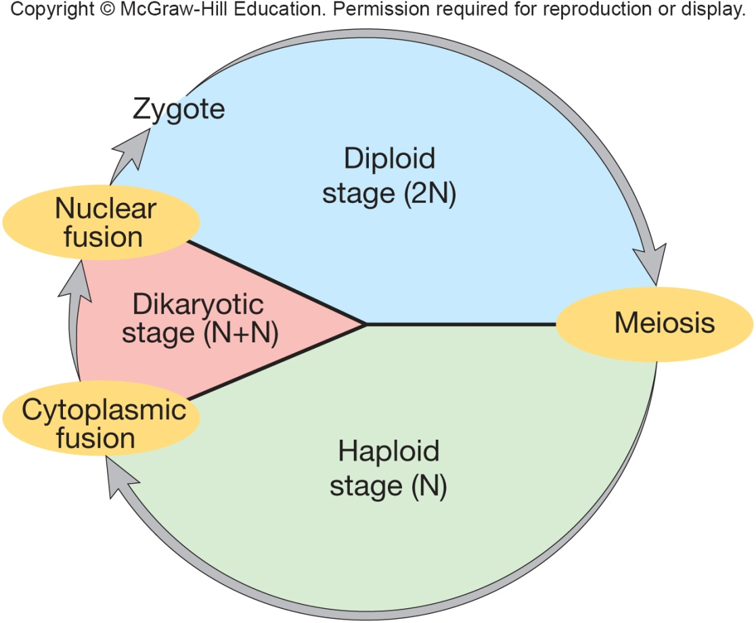
Fungal Reproduction - 2
Sexual reproduction
Involves fusion of compatible nuclei
Homothallic: Sexually-compatible gametes are formed on the same mycelium (self-fertilizing)
Heterothallic: Require outcrossing between different, yet compatible mycelia
A dikaryotic stage can exist temporarily prior to fusion of two haploid nuclei

Slide 13
26.2 Chytridiomycota Produce Motile Spores
Explain why chytrids are unique among fungi
Identify several habitats where chytrids grow
Describe general chytrid morphology

Slide 14
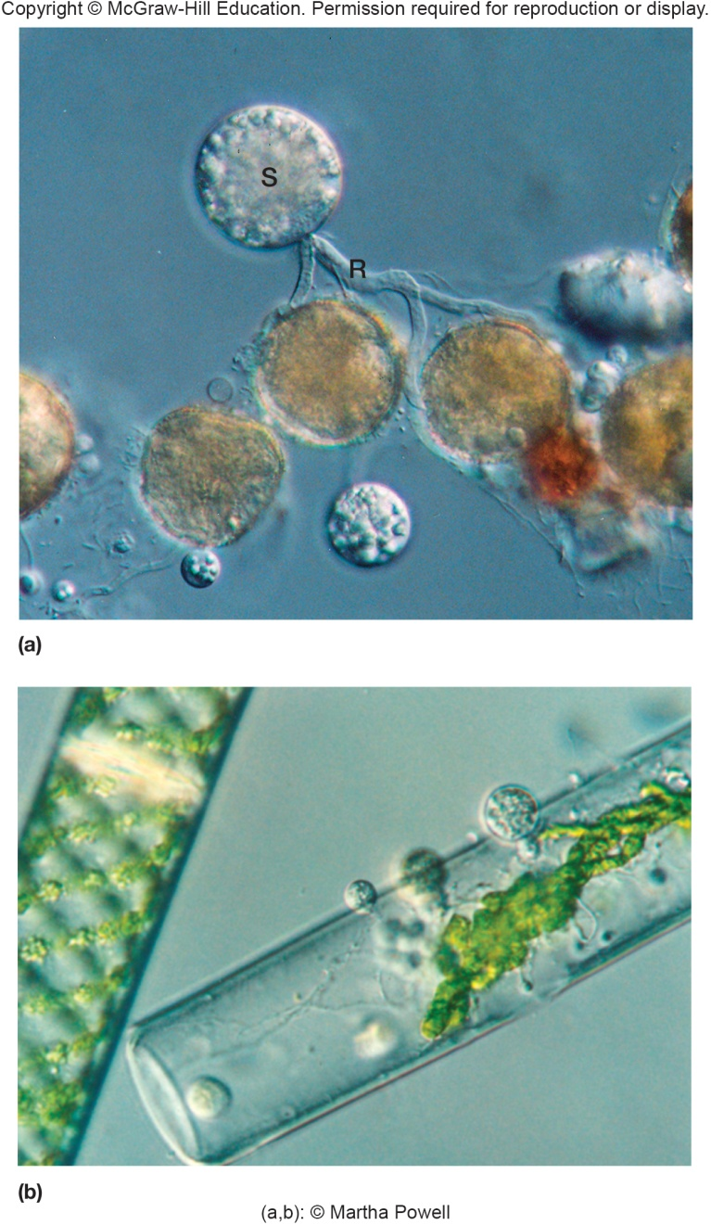
Chytridiomycota
Simplest fungi, also called chytrids
free living, saprophytic
parasitic forms infect aquatic plants and animals, insects
found in the anoxic rumen of herbivores
may be responsible for large-scale mortality of amphibians
Produce a zoospore with single, posterior, whiplash flagellum
most primitive form of spore dispersal
flagella lost in higher forms
Asexual and sexual reproduction
Many members degrade cellulose and keratin

Slide 15
26.3 Zygomycota: Fungi with Coenocytic Hyphae
Recognize zygomycetes in nature
Outline the life cycle of a Rhizopus species
List at least two reasons zygomycetes benefit humans

Slide 16
Zygomycota
Zygomycetes
Most are saprophytes
a few are plant and animal parasites
Form coenocytic hyphae containing numerous haploid nuclei
Some of industrial importance
foods, antibiotics and other drugs, meat tenderizer, and food coloring
Usually reproduce asexually by spores that develop at the tips of aerial hyphae
Sexual reproduction occurs when environmental conditions are not favorable
requires compatible opposite mating types
hormone production causes hyphae to produce gametes
gametes fuse, forming a zygote
zygote becomes zygospore

Slide 17
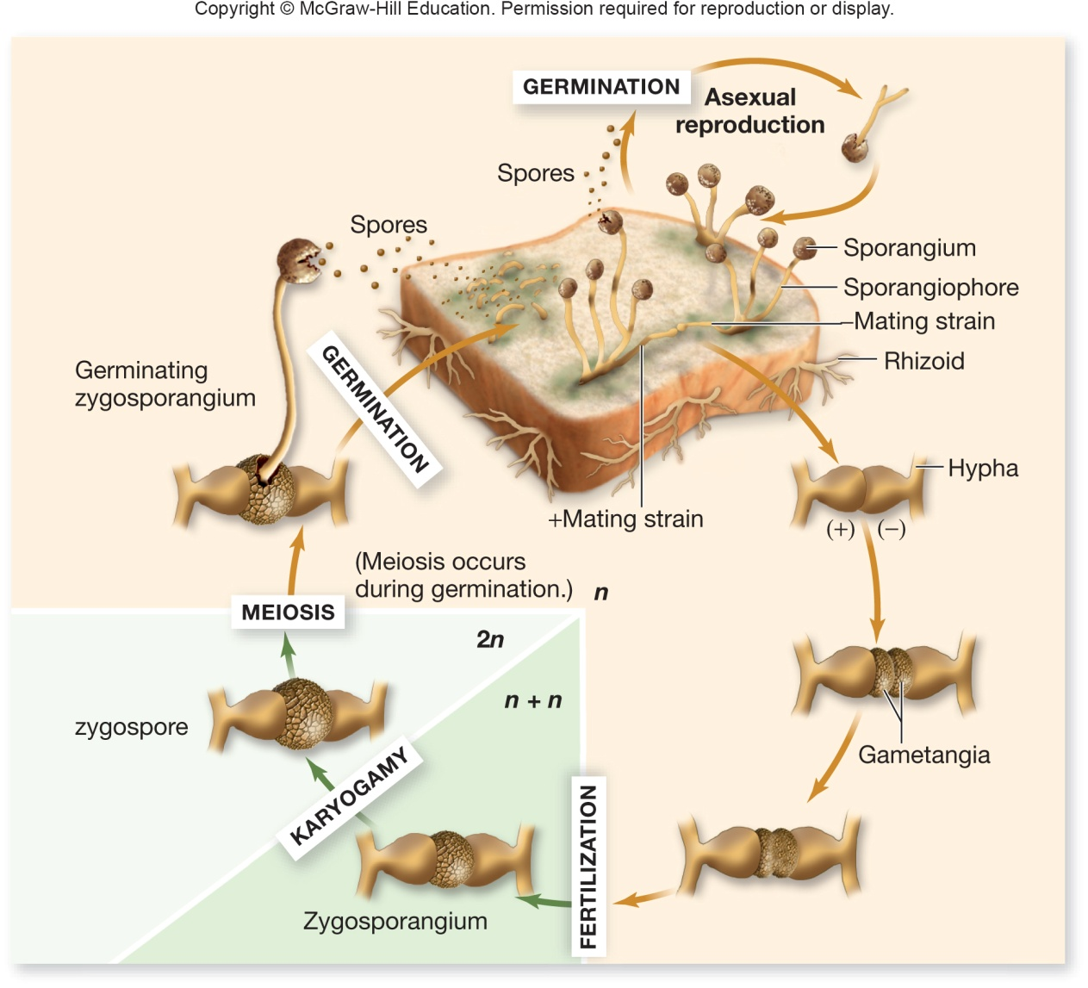
Genus Rhizopus
R. stolonifer
grows on surface of moist carbohydrate rich foods such as bread
hyphae quickly cover surface as rhizoids, absorb nutrients
stolon hyphae become form new rhizoids

Slide 18
Importance of Genus Rhizopus
Rhizopus-Burkholderia symbiosis
seedling blight in rice bacterium Burkholderia growing within Rhizopus produces toxin
Used to produce tempeh from soybeans
Used with soybeans to make sufu curd
Commercially
used to produce anesthetics, birth control, alcohols, meat tenderizers, yellow coloring in margarine

Slide 19
26.4 Glomeromycota Are Mycorrhizal Symbionts
Describe the functional importance of glomeromycetes
Differentiate between ectomycorrhizae and arbuscular mycorrhizae

Slide 20
Glomeromycota
Aseptate flat hyphae (appressoria) to penetrate host plants; produce large, multinucleate spores and only reproduce asexually
Major importance as mycorrhizal symbionts of vascular plants
form intracellular associations within roots of almost all herbaceous plants and tropical trees
Ectomycorrhizae do not penetrate root cells
Arbuscular mycorrhizae penetrate root cell wall
mutualistic relationship (both benefit)
fungus helps protect host from stress, delivers soil nutrients to the plant; plant provides carbohydrates to fungus

Slide 21
26.5 Ascomycota Includes Yeasts and Molds
Describe ecological, economic, and medical importance of ascomycetes
Diagram the Saccharomyces cerevisiae life cycle
Outline the mechanisms used by typical filamentous ascomycetes to reproduce, survive unfavorable conditions, and disperse
Explain the function of sclerotia
Identify the origin of St. Anthony’s fire, LSD, and “sick building syndrome”

Slide 22
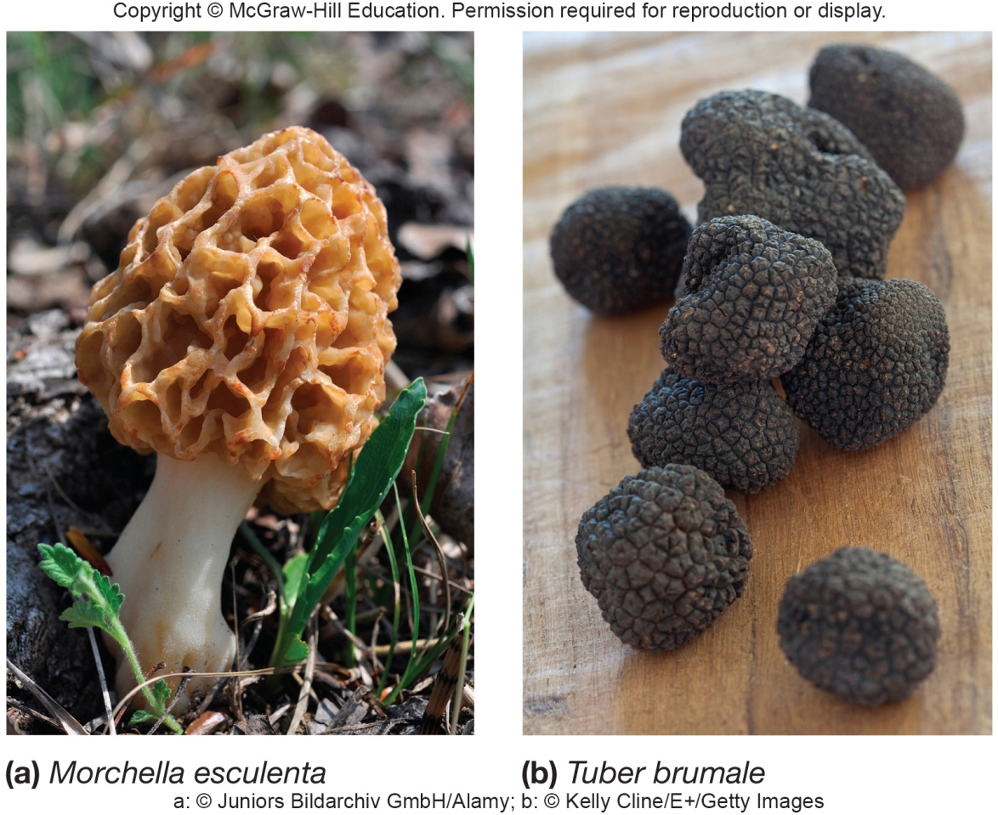
Ascomycota
Ascomycetes or sac fungi
found in freshwater, marine, and terrestrial habitats
red, brown, and blue-green molds cause food spoilage
some are human and plant pathogens
some yeasts and truffles are edible
some used as research tools

Slide 23
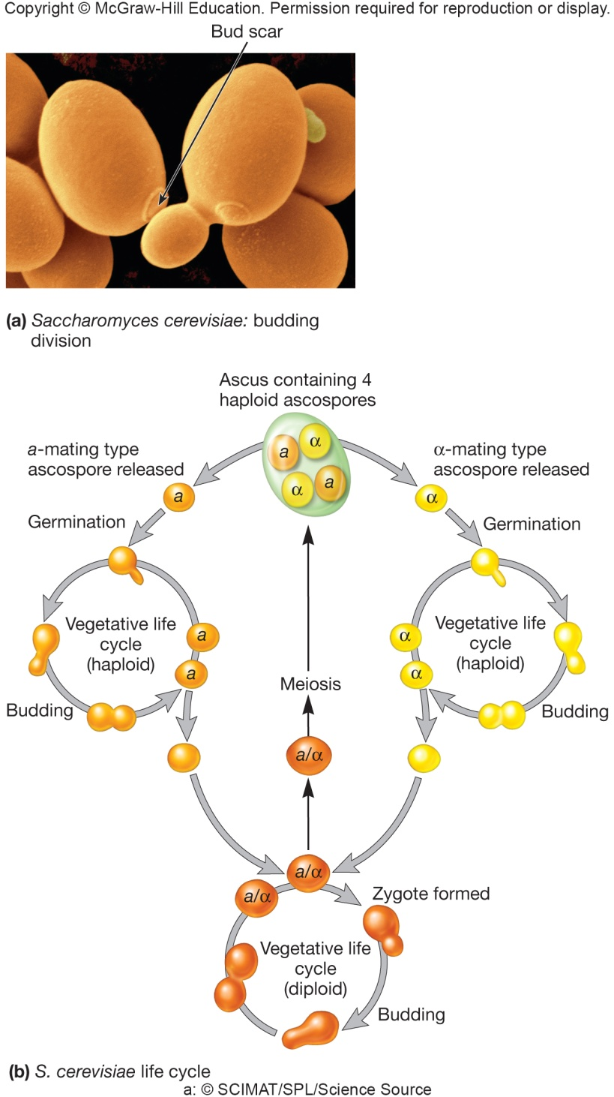
Ascomycota Yeast Life Cycle
Alternates between haploid and diploid
in nutrient rich, mitosis and budding occurs at non-scarred regions
stops after entire mother cell is scarred
nutrient poor, meiosis and haploid ascus containing ascospores formed
haploid cells of opposite mating types fuse
tightly regulated by pheromones

Slide 24
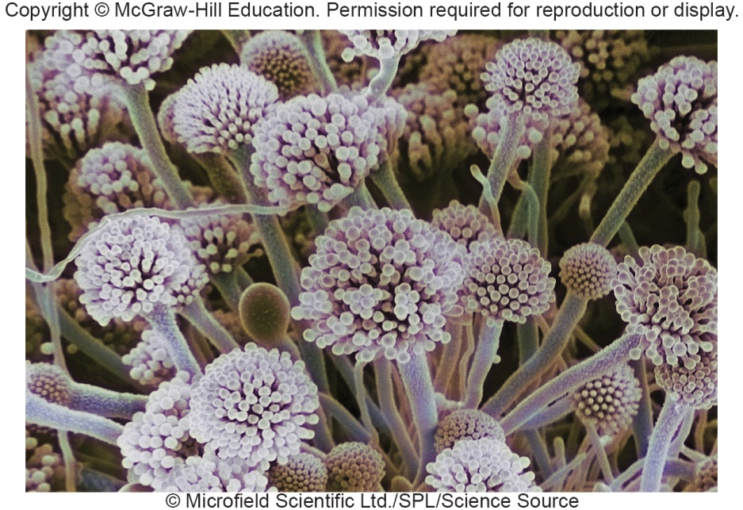
Ascomycota Filamentous Form Life Cycle
Asexual reproduction – conidia
Sexual reproduction
ascus formation with ascospores
opposite mating types form zygote
ascospores forcefully released from ascocarp, germinate
Sclerotia masses of hyphae survive the winter then germinate

Slide 25
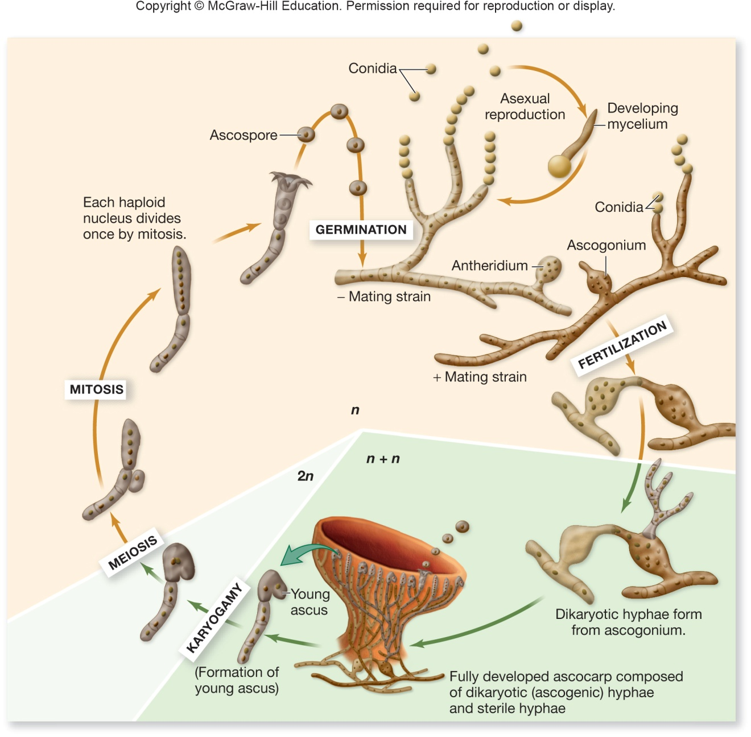
Typical Life Cycle of Filamentous Ascomycete

Slide 26
Genus Aspergillus
A. fumigatus
ubiquitous environmental
allergies and significant pathogen
A. oryzae
production of fermented foods
important in biotechnology
Aspergillus
37 Mb genome, model system

Slide 27
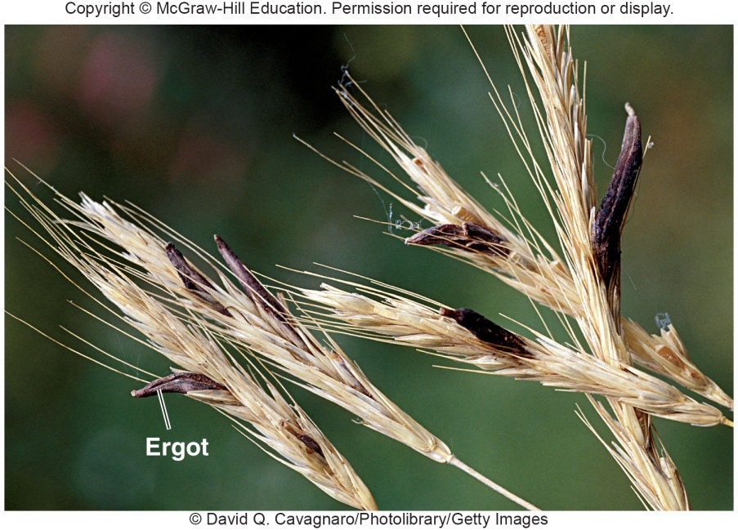
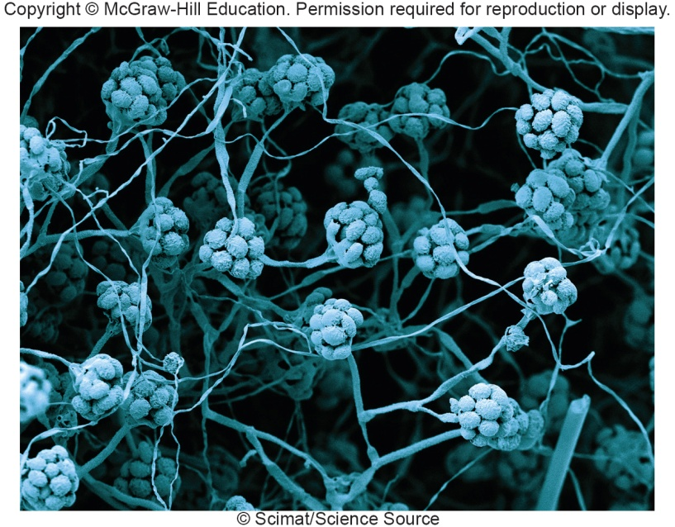
More Pathogenic Ascomycota
Claviceps purpura
parasite on higher plants
ergotism
toxic condition from eating infected grain
due to lysergic acid diethylamide (LSD)
Candida, Blastomyces, Histoplasma
human pathogens
Stachybotrys – “sick building syndrome”
Aspergillus – aflatoxins and cancer

Slide 28
26.6 Basidiomycota Includes Mushrooms and Plant Pathogens
Describe the life cycle of a typical basidiomycete
Identify the fungi that cause plant rusts
Describe one human and one plant disease caused by a basidiomycete

Slide 29
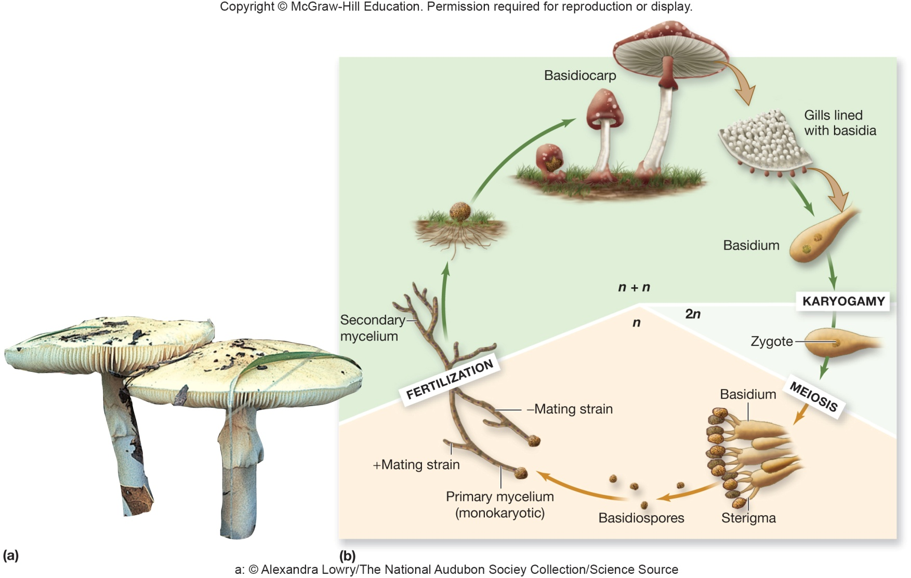
Basidiomycota
Basidiomycetes (club fungi)
examples include rusts, shelf fungi, puffballs, toadstools, mushrooms
sexual reproduction form basidium
basidiospores are released at maturity

Slide 30
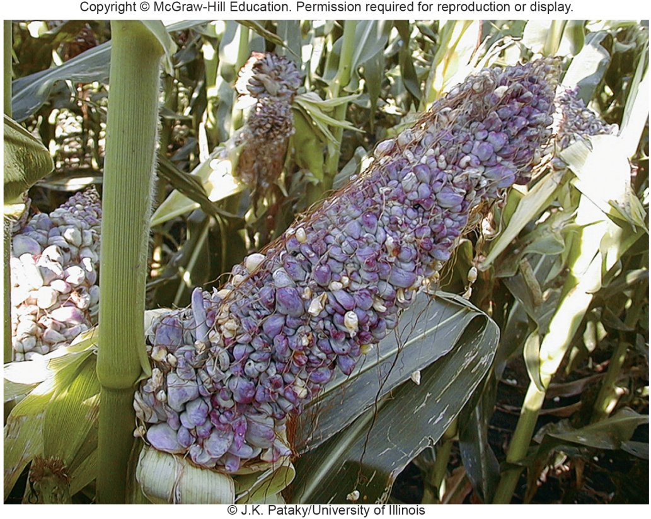
Basidiomycota Impact on Human Beings
Decomposers
Edible and non-edible mushrooms
toxins are poisons and hallucinogenic
Pathogens of humans, other animals, and plants
e.g. Cryptococcus neoformans – cryptococcosis
systemic infection, primarily of lungs and central nervous system

Slide 31
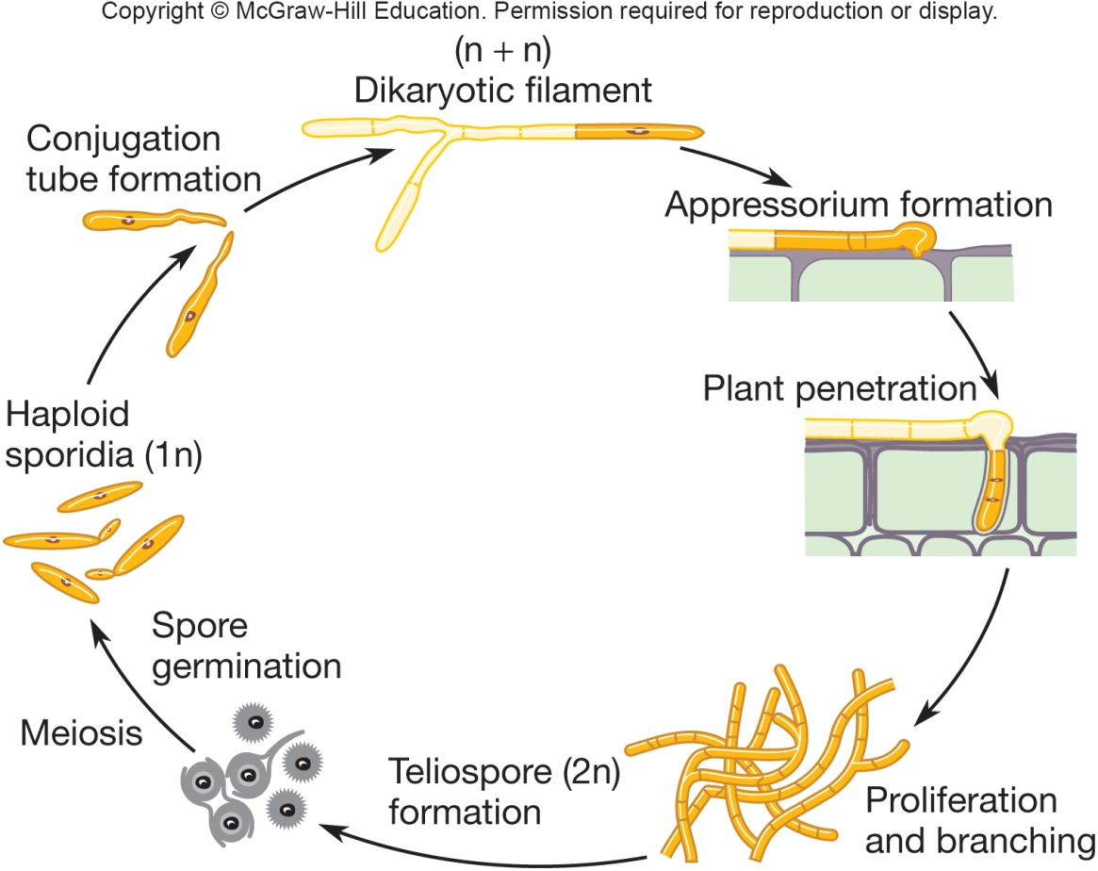
Urediniomycetes and Ustilaginomycetes
Plant pathogens causing “rusts” and “smuts’
dimorphic
yeasts are infectious form
mold - teliospores form tumors
Some urediniomycetes are also human pathogens

Slide 32
26.7 Microsporidia Are Intracellular Parasites
Explain why the Microsporidia are no longer considered protists
Describe the microsporidian life cycle and relate its unique morphology to host invasion
List at least two human diseases caused by microsporidia

Slide 33
Microsporidia
Obligate intracellular fungal parasites that infect insects, fish, and humans
Aquatic birds are common hosts and contribute to large numbers of spores in environment
Transitional form is a spore structure capable of surviving outside the host
Structurally similar to ‘classic’ fungi
contain chitin, trehalose, and mitosomes
however, lack mitochondria, peroxisomes and centrioles
unique morphology is polar tube essential for host invasion

Slide 34
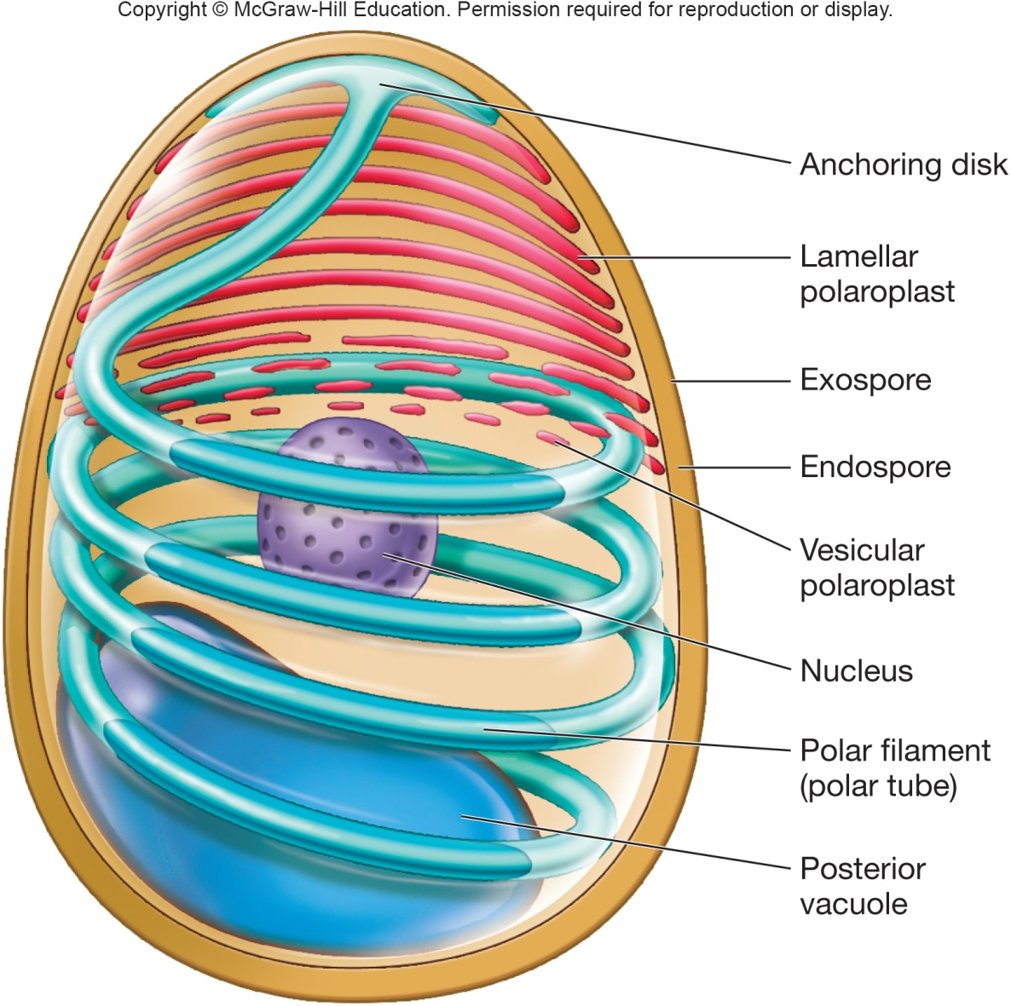
Microsporidia Pathogenesis
Human infections
Enterocystozoon bieneusi
diarrhea
Pneumonia
Encephalitozoon cuniculi
encephalitis
Nephritis
severe in HIV/AIDS patients

Slide 35
Take Home Message
Fungi are incredibly important to life on this planet, as they recycle nutrients from decomposition processes
But, they can sometimes grow in/on places we don’t want them to, causing diseases of plants and animals
This chapter gives you a quick rundown of the main groups of fungi, how they operate, and which ones can cause problems for humans and plants
It’s not meant to be comprehensive – but you should have a much better general understanding of the role of microbial fungi in the world after going through this material

